Slide 1

DATA ANALYSIS USING SQL FUNCTIONALITIES

Slide 2
ABOUT
Netflix is a popular streaming service that offers a wide variety of TV shows, movies, documentaries, and original content across different genres. It was founded in 1997 by Reed Hastings and Marc Randolph. The platform has since grown to become one of the leading streaming services globally.

Slide 3
Streaming Service: Netflix is a popular subscription-based streaming service.
Founding: Founded in 1997 by Reed Hastings and Marc Randolph.
Global Reach: Available in numerous countries worldwide.
Content Library: Offers a diverse range of TV shows, movies, documentaries, and original productions.
Subscription Model: Operates on a monthly subscription model with various plans.
Original Content: Invests heavily in producing original shows and movies.
Device Compatibility: Accessible on various devices, supporting offline viewing.
User Profiles: Allows users to create personalized profiles within a single account.
Evolution: A pioneer in the streaming industry, Netflix has played a significant role in changing how people consume entertainment.
KEY POINTS ABOUT

Slide 4
HOW WE ARE GOING TO ANALYZE THE DATA?
WE WILL GO QUESTION BY QUESTION AND ANSWER ALL THE QUESTION WITH QUERIES AND THEIR OUTPUTS

Slide 5

LET’S BEGIN

Slide 6
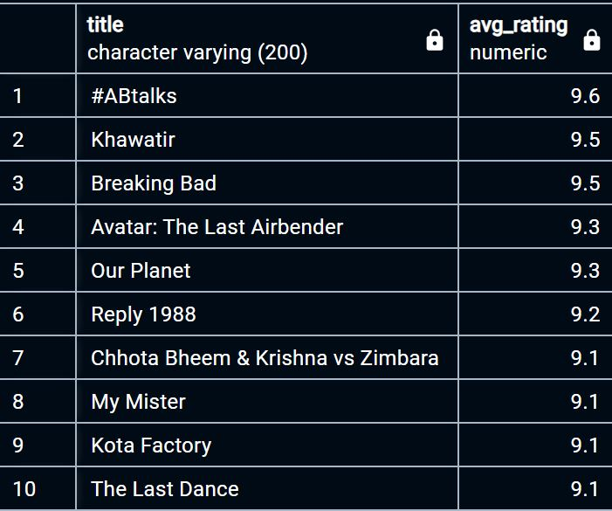
Query I have used:
select title,avg_rating from
(select title,round(avg(imdb_score),1) as avg_rating
from netflix_data
group by title
order by avg_rating desc)
where avg_rating is not null
limit 10
Output I got:
(Q1) List top 10 movies with
the Highest Average Rating?

Slide 7
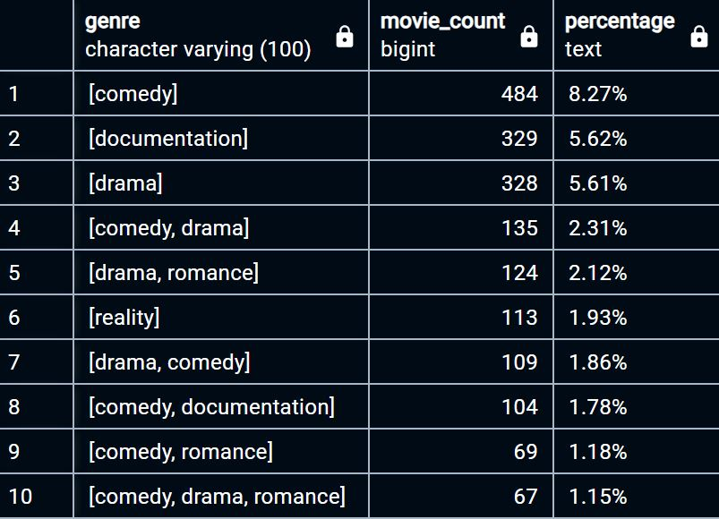
Query I have used:
select genre,count(*) as movie_count,round((count(*)*100.0/(select count(*) from netflix_data)),2)|| '%' as percentage
from netflix_data
group by genre
order by percentage desc
limit 10
Output I got:
(Q2) Calculate the percentage of movie that belong to each genre in the database

Slide 8
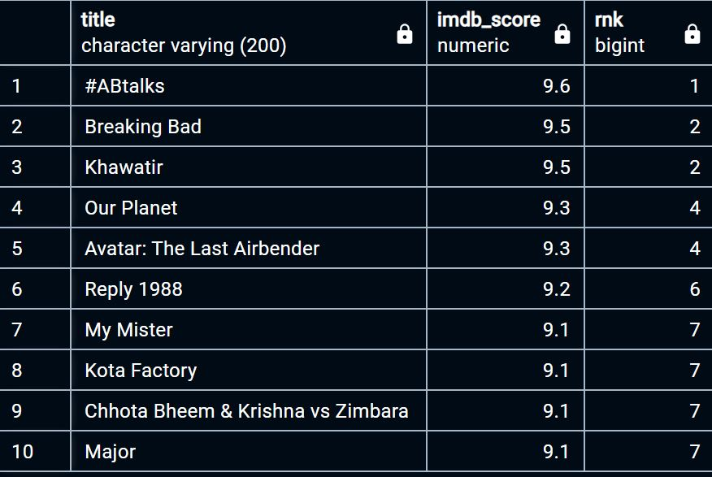
Query I have used:
select title,imdb_score,rank() over(order by imdb_score desc) as RNK
from netflix_data
where imdb_score is not null
limit 10
Output I got:
(Q3)Rank the Movie & Tv series on the basis of their IMDB Score

Slide 9
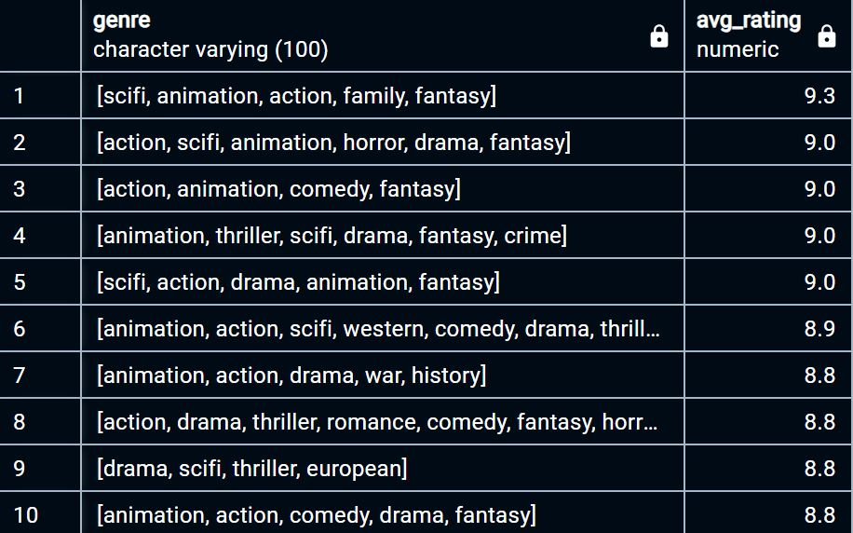
Query I have used:
select genre,avg_rating from
(select genre,round(avg(imdb_score),1) as avg_rating
from netflix_data
group by genre
order by avg_rating desc
)where avg_rating is not null
limit 10
Output I got:
(Q4)Find the average rating for the movie that belong to multiple genre

Slide 10
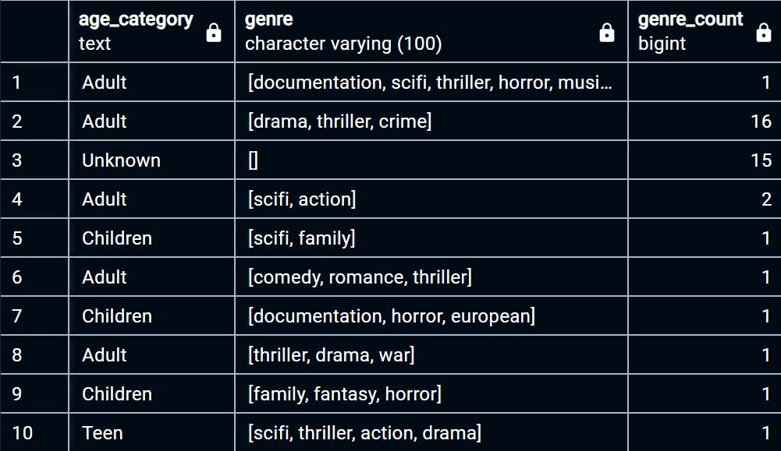
Query I have used:
select
Case
when Age_Certification<='PG' Then 'Children'
when Age_Certification<='PG_13' Then 'Teen'
when Age_Certification in ('R','TV-MA') Then 'Adult'
else 'Unknown'
end as Age_Category,Genre,
Count(*) as Genre_Count
from netflix_data
GROUP BY Age_Category,Genre;
Output I got:
(Q5) Categorize the Genre according to Age-Certification

Slide 11
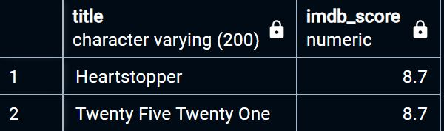
Query I have used:
select title,imdb_score
from netflix_data
where release_year=2022 and imdb_score=(select Max(Imdb_score) from netflix_data
where release_year=2022 and imdb_score<
(select max(imdb_score) from netflix_data where release_year=2022) );
Output I got:
(Q6) Find the 2nd Highest Ranked Movie that is Made in the the year 2022

